Slide 1
CREDIT CARD FRAUD DETECTION
USING MACHINE LEARNING
Guided by : Dr. R. R. Suman
Group No.: 40
Team Members
Ankesh 2021UGCS058
Betha Sushma 2021UGCS120

Slide 2
Title
Problem Statement
Introduction
Objectives
Dataset
Algorithm Used
Logistic Regression
K-Nearest Neighbour
Decision Tree
Gradient Boosting
XGBoost
LightGBM
Voting Classifier
Results
Future Work
References
TABLE OF CONTENTS

Slide 3
PROBLEM STATEMEMNT
Developing a machine learning model which should be capable of effectively detecting fraudulent transactions within credit card systems

Slide 4
INTRODUCTION
In a landscape where financial security is paramount, the detection and prevention of credit card fraud stand as pivotal challenges.
Given the impact of fraudulent activities on individuals and financial institutions, the ability to accurately forecast and mitigate such risks is of utmost importance.
Our objective is to leverage machine learning techniques to provide robust solutions for credit card fraud detection.
NumPy, Pandas, Matplotlib, Sklearn and many more form the foundation of our project. These libraries empowered us to manipulate data, build models and visualize results effectively.

Slide 5
OBJECTIVES
Data Collection and Preprocessing: Collect comprehensive datasets containing historical credit card transaction data from reputable sources.
Feature Selection: Identify pertinent features within the transactional data that may serve as indicators of fraudulent activity.
Model Selection and Implementation: Evaluate a range of machine learning algorithms tailored for fraud detection tasks.
Visualization: Utilize visualization tools to present the findings of the project in a clear and comprehensible manner.

Slide 6
DATASET
The data of credit card transactions made by European Card Holders was used for the model training.
It was accessed from https://www.kaggle.com/datasets/mlg-ulb/creditcardfraud
This dataset presents transactions that occurred in two days, where we have 492 fraud out of 2,84,807 transactions.
It contains features like Time, Amount of Transaction, Class, v1, v2, …, v28.
It contains only numerical input variables which are the result of PCA transformation.

Slide 7
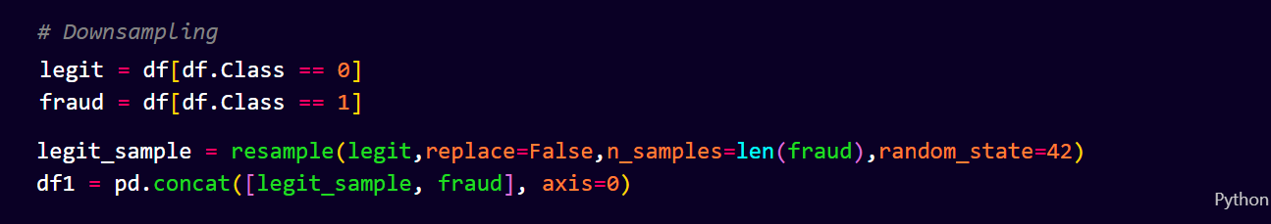
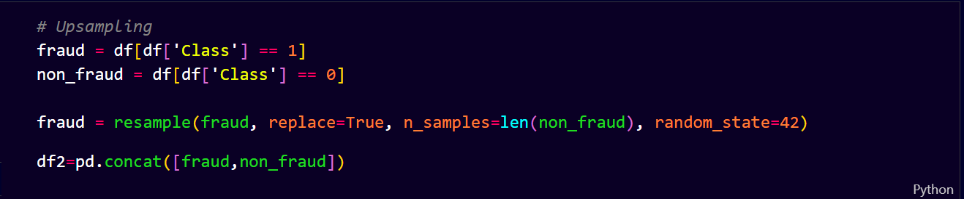
Since the dataset is unbalanced, down sampling and up sampling of data is done.
Down Sampling:
Up Sampling:

Slide 8
ALGORITHMS USED
Three algorithms were applied on the data set:-
Logistic Regression
K-Nearest Neighbours (KNN)
Decision Tree
Gradient Boosting
XGBoost
LightGBM
Voting Classifier
Each algorithms were applied on the up sampled and down sampled data.

Slide 9
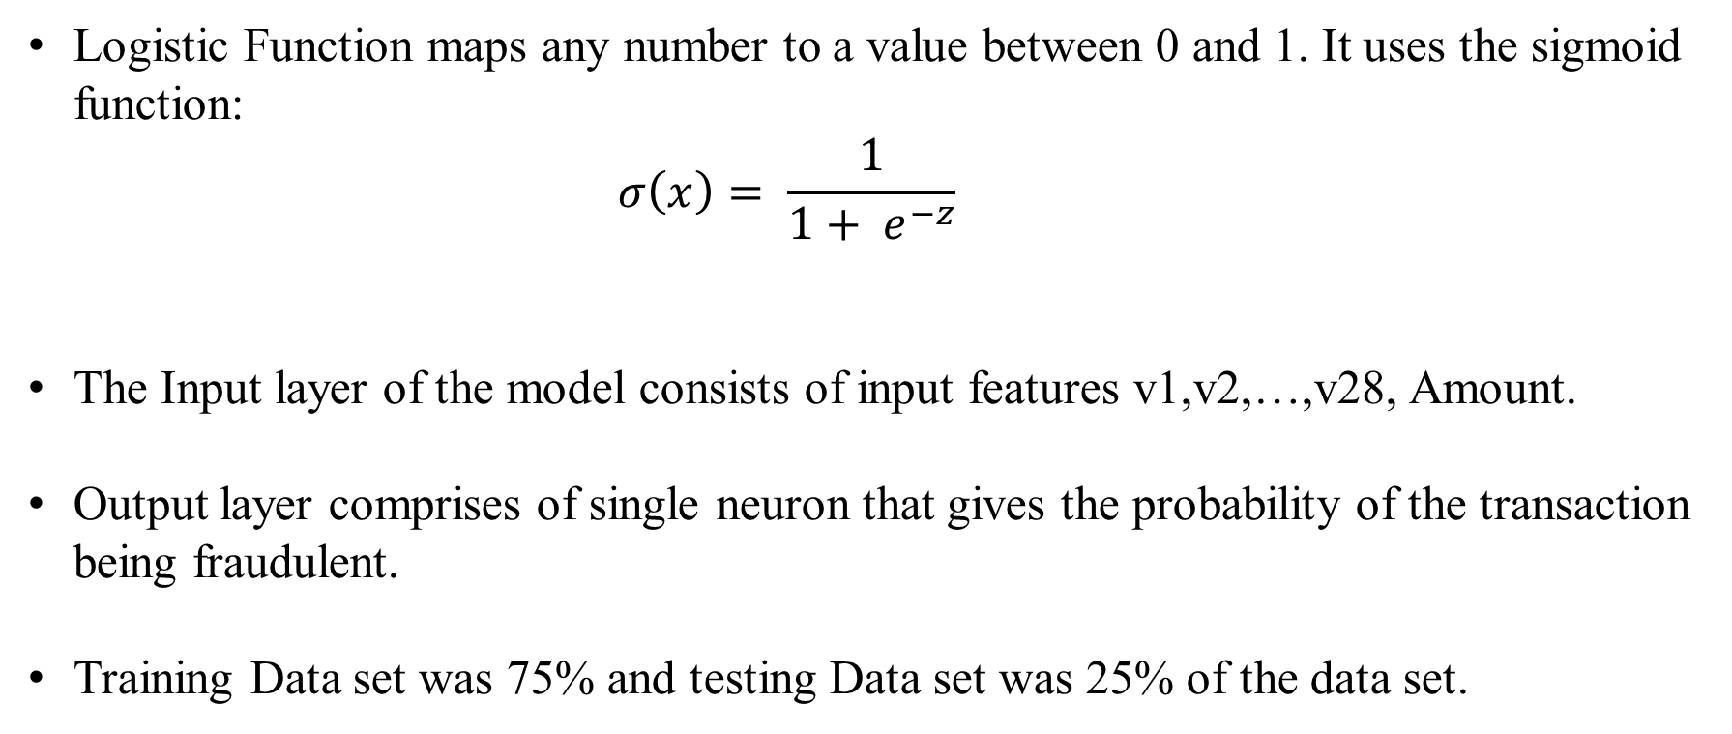
Logistic Regression
Logistic Function maps any number to a value between 0 and 1. It uses the sigmoid function:
$$σ\left(x\right)= \frac{1}{1+ e^{−z}}$$
The Input layer of the model consists of input features v1,v2,…,v28, Amount.
Output layer comprises of single neuron that gives the probability of the transaction being fraudulent.
Training Data set was 75% and testing Data set was 25% of the data set.

Slide 10
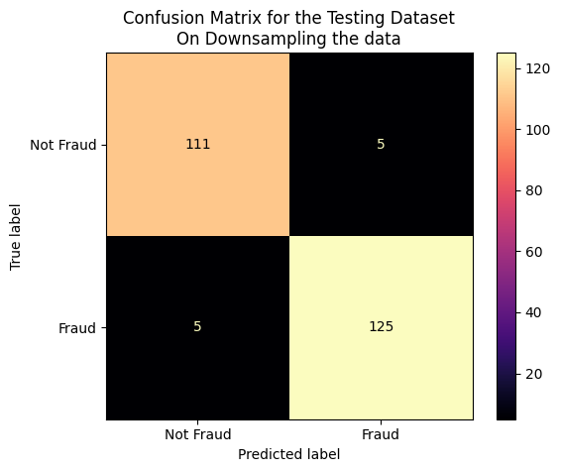
Logistic Regression
It was applied on the Down Sampled Data. It’s results are:-
No. of Correct Predictions :
236
No. of Wrong Predictions :
10
Accuracy : 95.93%

Slide 11
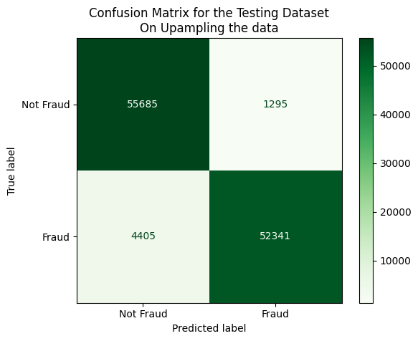
Logistic Regression
It was applied on the Up Sampled Data. It’s results are:-
No. of Correct Predictions :
1,08,026
No. of Wrong Predictions :
5700
Accuracy : 94.98%

Slide 12
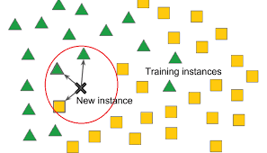
K-Nearest Neighbour (KNN)
KNN relies on the similarities between data points in a feature space. It operates by selecting the k nearest neighbours of a given data point based on the computed distances.
The Input layer of the model consists of input features v1,v2,…,v28, Amount.
Output layer comprises of single neuron that gives the probability of the transaction being fraudulent.
Training Data set was 75% and testing Data set was 25% of the data set.

Slide 13
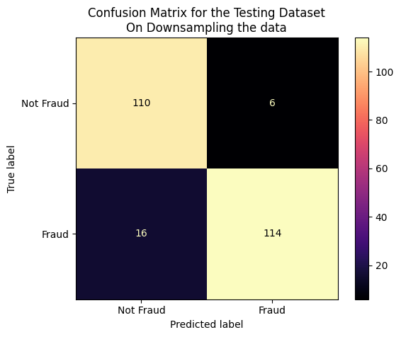
K-Nearest Neighbour (KNN)
It was applied on the Down Sampled Data. It’s results are:-
No. of Correct Predictions :
224
No. of Wrong Predictions :
22
Accuracy : 91.06%

Slide 14
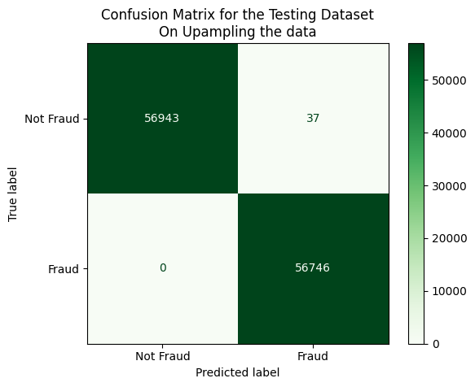
K-Nearest Neighbour (KNN)
It was applied on the Up Sampled Data. It’s results are:-
No. of Correct Predictions :
1,13,689
No. of Wrong Predictions :
37
Accuracy : 99.96%

Slide 15
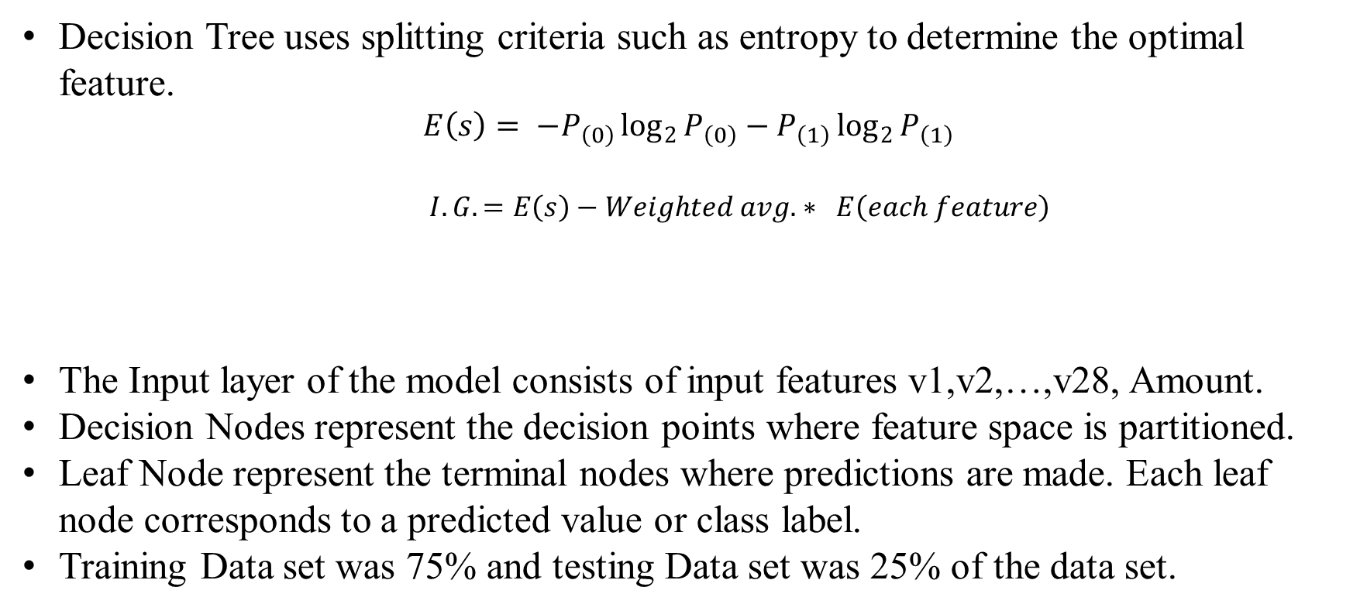
Decision Tree
Decision Tree uses splitting criteria such as entropy to determine the optimal feature.
$$E\left(s\right)= −P_{\left(0\right)}\log_{2}{P_{\left(0\right)}}−P_{\left(1\right)}\log_{2}{P_{\left(1\right)}}$$
$I.G. =E\left(s\right)−Weighted avg. ∗ E\left(each feature\right)$
The Input layer of the model consists of input features v1,v2,…,v28, Amount.
Decision Nodes represent the decision points where feature space is partitioned.
Leaf Node represent the terminal nodes where predictions are made. Each leaf node corresponds to a predicted value or class label.
Training Data set was 75% and testing Data set was 25% of the data set.

Slide 16
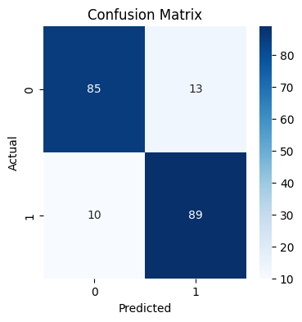
Decision Tree
It was applied on the Down Sampled Data. It’s results are:-
No. of Correct Predictions :
174
No. of Wrong Predictions :
23
Accuracy : 88.32%

Slide 17
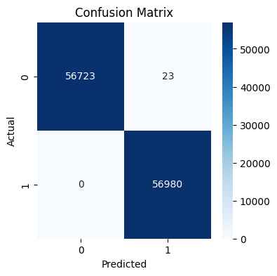
Decision Tree
It was applied on the Up Sampled Data. It’s results are:-
No. of Correct Predictions :
1,13,703
No. of Wrong Predictions :
23
Accuracy : 99.97%

Slide 18
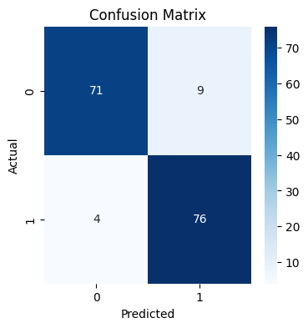
Decision Tree
It was applied on selecting 400 random samples from both classes randomly. Model was trained using 640 data points and tested on 160 data points. It’s results are:-
No. of Correct Predictions :
147
No. of Wrong Predictions :
13
Accuracy : 91.88%

Slide 19
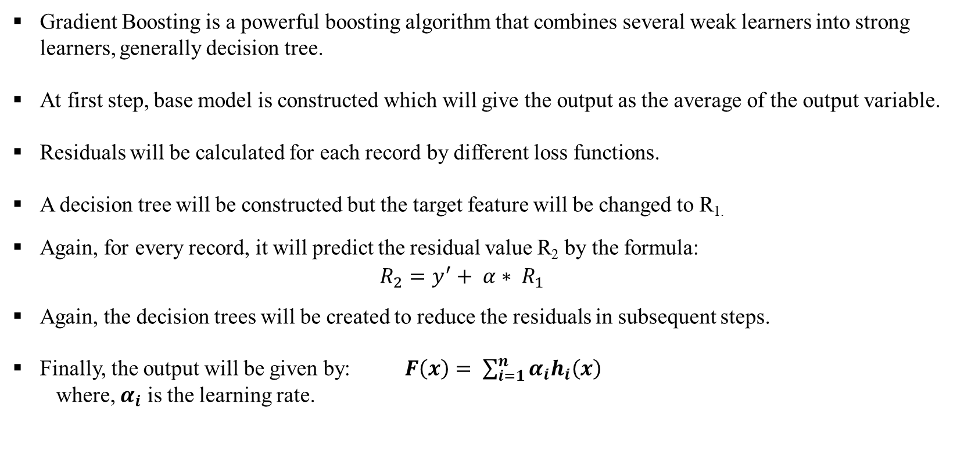
Gradient Boosting
Gradient Boosting is a powerful boosting algorithm that combines several weak learners into strong learners, generally decision tree.
At first step, base model is constructed which will give the output as the average of the output variable.
Residuals will be calculated for each record by different loss functions.
A decision tree will be constructed but the target feature will be changed to R_{1.}
Again, for every record, it will predict the residual value R₂ by the formula:
$$R_{2}=y^{′}+ α∗ R_{1}$$
Again, the decision trees will be created to reduce the residuals in subsequent steps.
Finally, the output will be given by: $F\left(x\right)= \sum_{i=1}^{n}{α_{i}h_{i}\left(x\right)}$
where, $α_{i}$ is the learning rate.

Slide 20
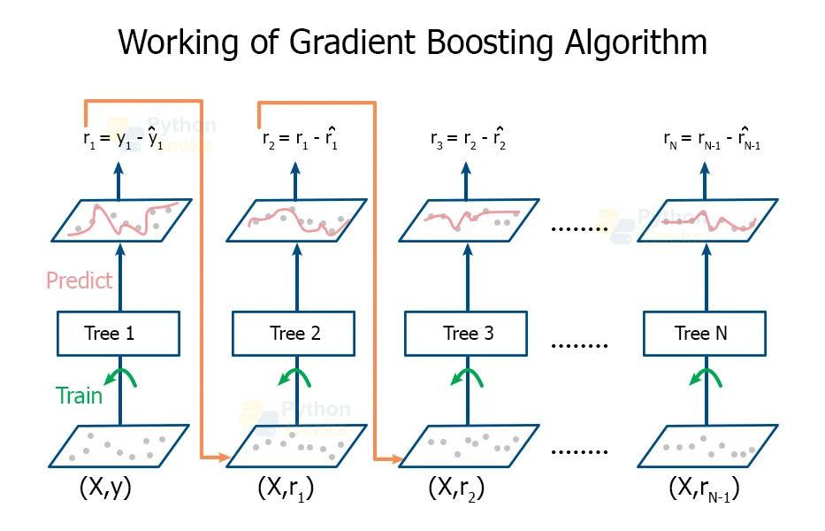

Slide 21
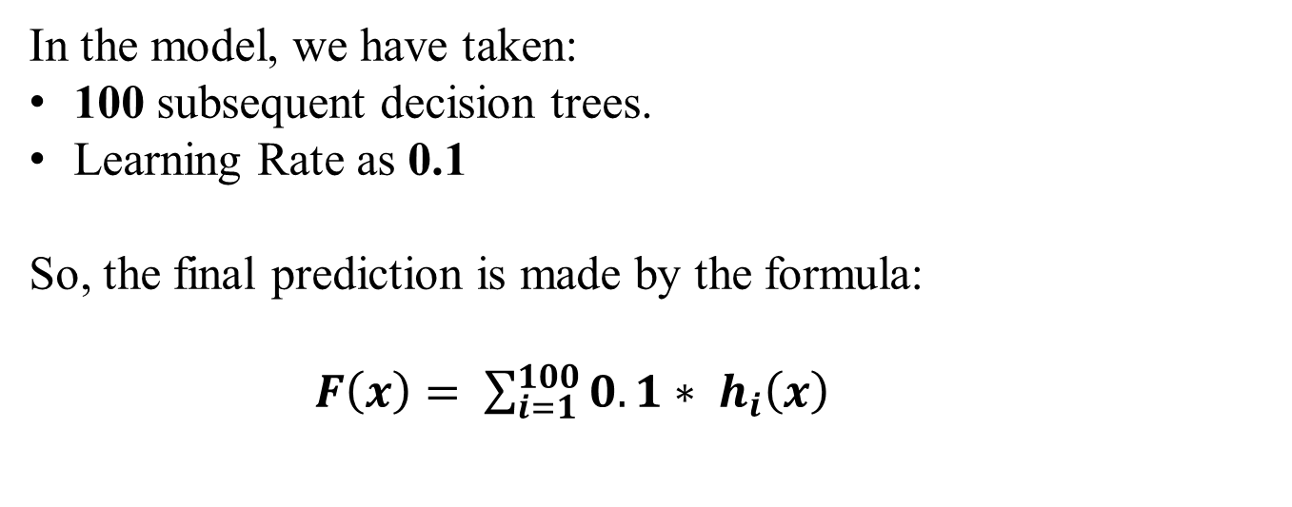
Gradient Boosting
In the model, we have taken:
100 subsequent decision trees.
Learning Rate as 0.1
So, the final prediction is made by the formula:
$F\left(x\right)= \sum_{i=1}^{100}{0.1∗ h_{i}\left(x\right)}$

Slide 22
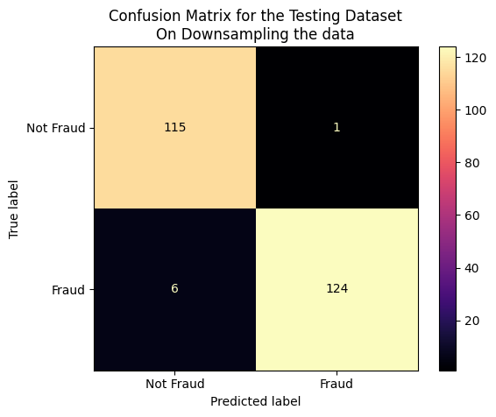
Gradient Boosting
It was applied on the Down Sampled Data. It’s results are:-
No. of Correct Predictions :
239
No. of Wrong Predictions :
7
Accuracy : 97.15%

Slide 23
Gradient Boosting
It was applied on the Up Sampled Data. It’s results are:-
No. of Correct Predictions :
1,13,689
No. of Wrong Predictions :
37
Accuracy : 99.96%

Slide 24
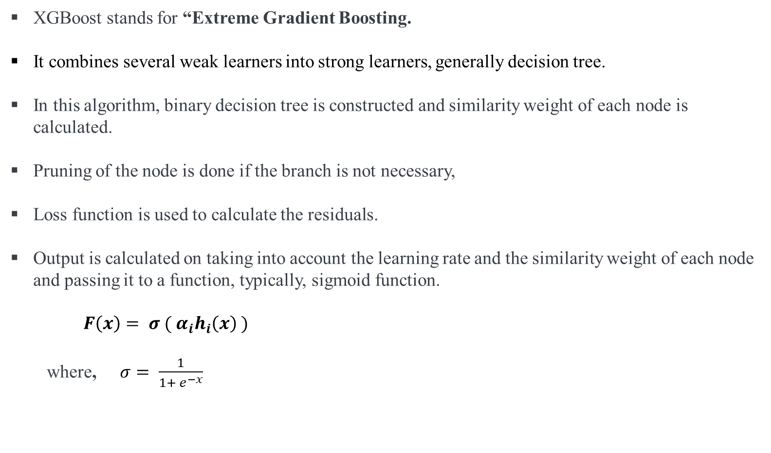
XGBoost
XGBoost stands for “Extreme Gradient Boosting.
It combines several weak learners into strong learners, generally decision tree.
In this algorithm, binary decision tree is constructed and similarity weight of each node is calculated.
Pruning of the node is done if the branch is not necessary,
Loss function is used to calculate the residuals.
Output is calculated on taking into account the learning rate and the similarity weight of each node and passing it to a function, typically, sigmoid function.
$F\left(x\right)= σ ( α_{i}h_{i}\left(x\right) )$
where, $σ= \frac{1}{1+ e^{−x}}$

Slide 25
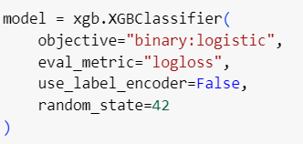
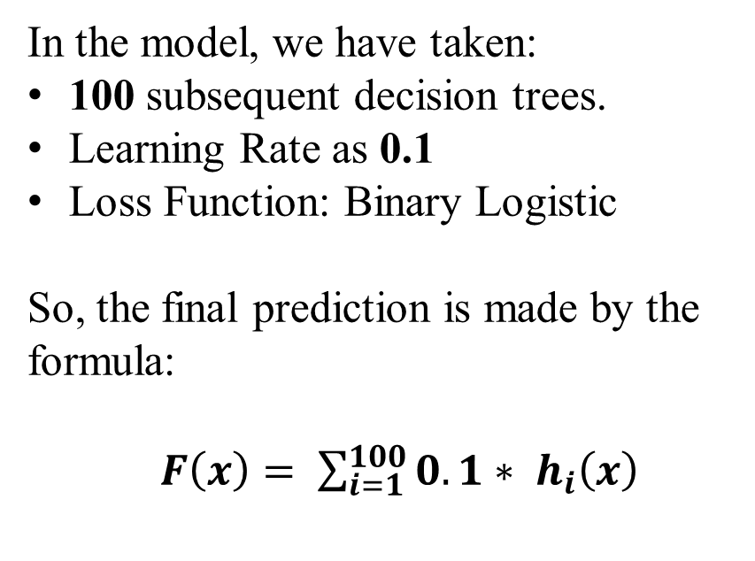
XGBoost
In the model, we have taken:
100 subsequent decision trees.
Learning Rate as 0.1
Loss Function: Binary Logistic
So, the final prediction is made by the formula:
$F\left(x\right)= \sum_{i=1}^{100}{0.1∗ h_{i}\left(x\right)}$

Slide 26

XGBoost
It was applied on the Down Sampled Data. It’s results are:-
No. of Correct Predictions :
233
No. of Wrong Predictions :
13
Accuracy : 94.71%

Slide 27

XGBoost
It was applied on the Up Sampled Data. It’s results are:-
No. of Correct Predictions :
113719
No. of Wrong Predictions :
7
Accuracy : 99.99%

Slide 28
LightGBM
LightGBM is a gradient boosting framework that uses tree-based learning algorithms.
LightGBM uses a smart technique to pick the most helpful data points for building trees, which helps it learn faster. It focuses on growing tree branches where they matter the most, making the learning process more efficient.
These strategies allow LightGBM to train quickly and accurately even with large datasets.
Key features include faster training speed, lower memory usage, and better accuracy.

Slide 29
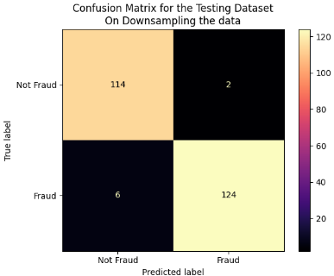
Confusion Matrix for LightGBM on Down Sampled Data
For Class 0, precision is 0.95, recall is 0.98, and F1-score is 0.97, with a support of 116
For Class 1, precision is 0.98, recall is 0.95, and F1-score is 0.97, with a support of 130.

Slide 30
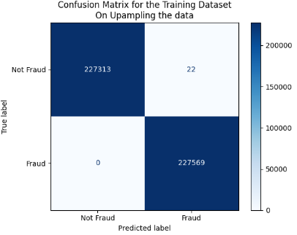
Confusion Matrix for LightBGM on UpSampled Data
The accuracy on the training data is approximately 0.99995.
For Class 0, precision, recall, and F1-score are approximately 1.00, with a support of 227,335.
For Class 1, precision, recall, and F1-score are approximately 1.00, with a support of 227,569.

Slide 31
Soft Voting Classifier
Soft Voting Classifier combines the predictions of multiple base estimators and predicts the class with the highest average probability.
Components: Decision Tree, Random Forest, Logistic Regression
Instead of relying solely on one model, it takes into account the collective wisdom of all models involved. This approach often leads to more robust predictions, as It considers different perspective from each model.

Slide 32
Soft Voting Classifier
Soft voting is particularly effective when individual models complement each other's strengths and weaknesses.
Complementary Nature:
Decision trees' complexity is balanced by random forests' robustness.
Random forests mitigate overfitting, enhancing logistic regression's interpretability.
Logistic regression provides simplicity, adding diversity to the ensemble.

Slide 33
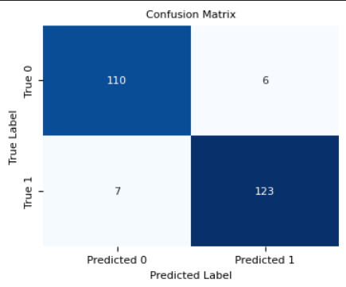
Confusion Matrix for Voting Classifier on Down Sampled Data
For Class 0, precision is 0.94, recall is 0.95, and F1-score is 0.94 with a support of 116.
For Class 1, precision is 0.95, recall is 0.95, and F1-score is 0.95 with a support of 130.

Slide 34
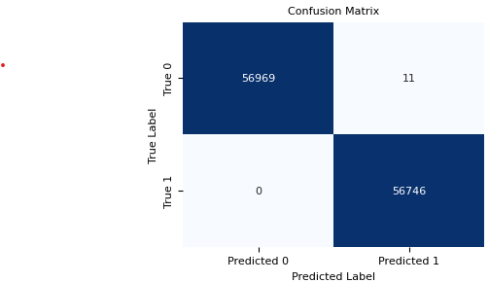
Confusion Matrix for Voting Classifier on Up Sampled Data
For Class 0, precision, recall, and F1-score are approximately 1.00, with a support of 56,980.
For Class 1, precision, recall, and F1-score are approximately 1.00, with a support of 56,746.

Slide 35
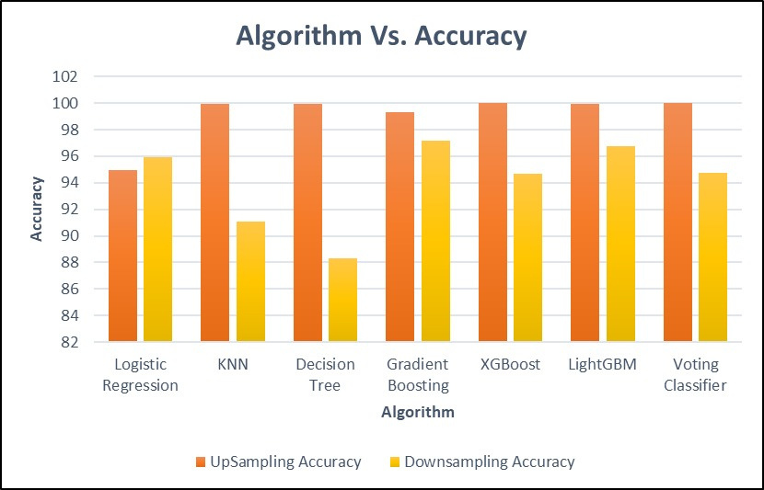
RESULTS
Up Sampling Accuracy
Down Sampling Accuracy

Slide 36
RESULTS

Slide 37
RESULTS
Excluding Logistic Regression and Gradient Boosting,

Slide 38
RESULTS

Slide 39
Comparing Accuracy between different models
XGBoost
Down sampling: 94.72% accuracy, 13 wrong predictions.
Up sampling: 99.99% accuracy, 7 wrong predictions.
Voting Classifier
Down sampling: 94.72% accuracy, 13 wrong predictions.
Up sampling: 99.99% accuracy, 11 wrong predictions.
Gradient Boosting (GBM)
Down sampling: 96.74% accuracy, 8 wrong predictions.
Up sampling: 99.32% accuracy, 767 wrong predictions.
LightGBM
Down sampling: 96.74% accuracy, 8 wrong predictions.
Up sampling: 99.99% accuracy, 22 wrong predictions.

Slide 40
CONCLUSION
These four models demonstrate strong performance in credit card fraud detection.
Across both down sampling and up sampling techniques, the models consistently achieve high levels of accuracy, ranging from 94.72% to 99.99%.
All models effectively identify fraudulent transactions with minimal errors.
Overall, the results indicate the effectiveness of machine learning algorithms in detecting credit card fraud, with potential applications in enhancing financial security measures.

Slide 41
SCOPE FOR FUTURE WORK
Real-Time Monitoring Systems: Developing real-time monitoring systems to detect fraud promptly and prevent financial losses.
User-Friendly Interface: Design an intuitive user interface to facilitate easy interaction with the model, making it accessible for users without technical expertise.

Slide 42
REFERENCES
Credit Card Fraud Detection using Machine Learning Algorithms by Vaishnavi Nath Dornadula et. Al. (2019)
Enhanced Credit Card Fraud Detection based on attention mechanism and LSTM deep model by Ibtissam Benchaji et. Al. (2021)
Credit Card Fraud Detection using hierarchical behavior-knowledge space model by Asoke K. Nandi et. Al. (2022)
Credit Card Fraud Detection by Munira Ansari et. Al. (2021)
Dataset Used – Credit Card Fraud Detection:
https://www.kaggle.com/datasets/mlg-ulb/creditcardfraud

Slide 43
THANK
YOU!

